Slide 1
The Management of Healthcare Workers Infected with HBV, HCV and/or HIV in the United States.
David K. Henderson, M.D.
Disclosure : Spouse works for Merck, Inc.
Presentation Includes: Discussion of unapproved off-label and/or investigational uses (prophylaxis) of one or more products (antivirals).

Slide 2
Iatrogenic Risks for HBV, HCV and HIV Transmission
Historical Perspective - Epistemology
The Magnitude of Occupational Risks
What We Have Learned about Primary and Secondary Prevention
Managing Providers Infected with HBV, HCV or HIV

Slide 3
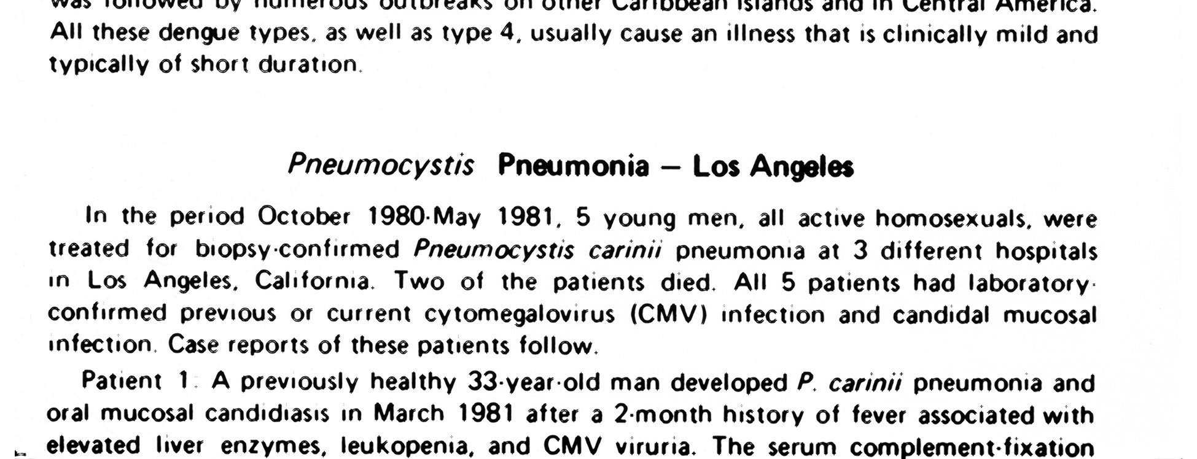
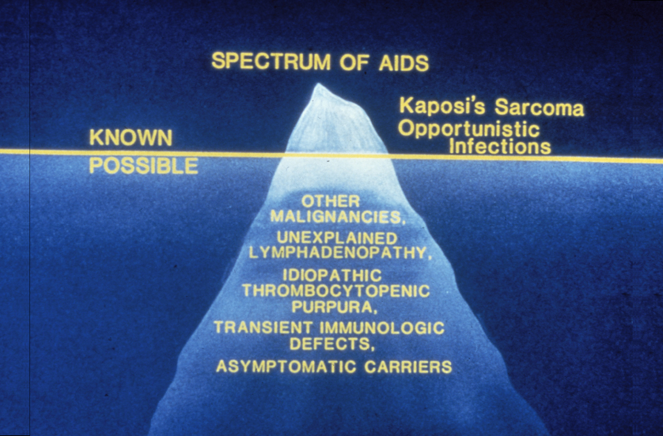
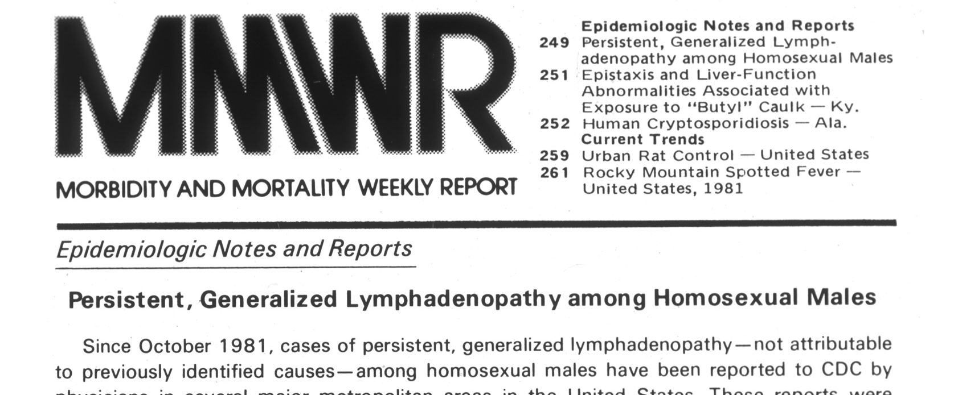

Slide 4
Iatrogenic Risks for HBV, HCV and HIV Transmission
Historical Perspective - Epistemology
The Magnitude of Occupational Risks
What We Have Learned about Primary and Secondary Prevention
Managing Providers Infected with HBV, HCV or HIV

Slide 5
What is the magnitude of risk for occupational HIV infection associated with a single parenteral exposure to blood from an HIV-HCV or HBV-infected patient?

Slide 6
Risk for Occupational HIV Infection Following Percutaneous Exposures
Number of Studies 21
Number of Participants 6,267
Number of Percutaneous Exposures 6,498
Number of Seroconversions 21
Infection Rate per Participant 0.34%
Infection Rate per Exposure 0.32%

Slide 7
Comparative Risks for Hepatitis B Transmission
Risk for Transmission of Hepatitis B following a parenteral occupational exposure to ‘e’ antigen positive blood
27 - 43%
Risk for clinical hepatitis severe enough to require hospitalization
6 - 24%

Slide 8
Comparative Risks for Hepatitis C Transmission
Number of Studies 25
Number of Percutaneous Exposures 2357
Number of Infections 44
Infection Rate per Exposure 1.9%
Range of Infection Rates 0 – 22.2%
Henderson DK. Clin Microbiol Rev;16(3):546-68.

Slide 9
Iatrogenic Risks for HIV Transmission
Historical Perspective - Epistemology
The Magnitude of Occupational Risks
What We Have Learned about Primary and Secondary Prevention
Managing Providers Infected with HBV, HCV or HIV

Slide 10
Primary Prevention
Reducing Risk for Exposure
Thoughtful Use of Universal/Standard Precautions
Education – Retraining Staff about Occupational Risks
Modification of Procedures and Work Practices
Modification of Medical/Nursing School Curricula
Engineered Controls – Use of Technological Advances

Slide 11
Parenteral Injuries/1000 Discharges, 1985 – 2013, NIH Clinical Center
Injuries/1000 Discharges
2009
2010
2011
1997
2012
1998
1999
2000
2001
2002
2003
2004
2005
2006
2007
1985
2008
2013
1986
1987
1988
1989
1990
1991
1992
1993
1994
1995
1996

Slide 12
Occupational HIV Infections by Year of Exposure Reported to CDC 1985 – 2014
Data Courtesy of Elise Beltrami, M.D.,
Denise Cardo, M.D., Lisa Panlilio, M.D. and David Kuhar, M.D., all from DHQP, CDC
Documented Occupational Infections
2009
2010
2011
2012
2013
1997
2014
1998
1999
2000
2001
2002
2003
2004
2005
2006
2007
1985
1988
1991
1994
2008
1986
1987
1989
1990
1992
1993
1995
1996

Slide 13
Factors Likely Contributing to the Observed Decrease in Occupational and Iatrogenic HIV Transmissions
Efficacy of HAART in lowering patients’ viral burdens.
Efficacy of Primary Prevention (i.e., fewer exposures due to use of Universal/Standard Precautions).
Decreased reporting to CDC / less aggressive case-finding.
Efficacy of HAART in decreasing hospitalizations, as well as the numbers and types of procedures required.
Presumed efficacy of Secondary Prevention (i.e., efficacy of antiretroviral PEP).

Slide 14
Iatrogenic Risks for HIV, HBV, and HCV Transmission
Historical Perspective - Epistemology
The Magnitude of Occupational Risks
What We Have Learned about Primary and Secondary Prevention
Managing Providers Infected with HBV, HCV or HIV

Slide 15
Nosocomial Epidemiology of HIV Infection
Patient to provider transmission
Patient to patient transmission
Provider to patient transmission
}
ALL occur

Slide 16
Nosocomial Epidemiology of HIV Infection
Patient to provider transmission – Common
Patient to patient transmission – Infrequent
Provider to patient transmission – Rare

Slide 17
Primum non Nocere

Slide 18
Hepatitis B Transmission – Provider-to-Patient
Through 1994, CDC investigators identified 42 instances of provider-to-patient HBV transmission (375 patients).
Bell D, et al. Surg Clin North Amer. 1995;75:1189-1203.
Two additional clusters of HBV infection occurred (both from HBeAg-positive surgeons).
  Four patients of an orthopedic surgeon.
    Johnston B, et al. Infect Control Hosp Epidemiol. 1994;15:352.
  19 patients of a thoracic surgery resident
    Harpaz R, et al. N Engl J Med. 1996;334(9):549-554.

Slide 19
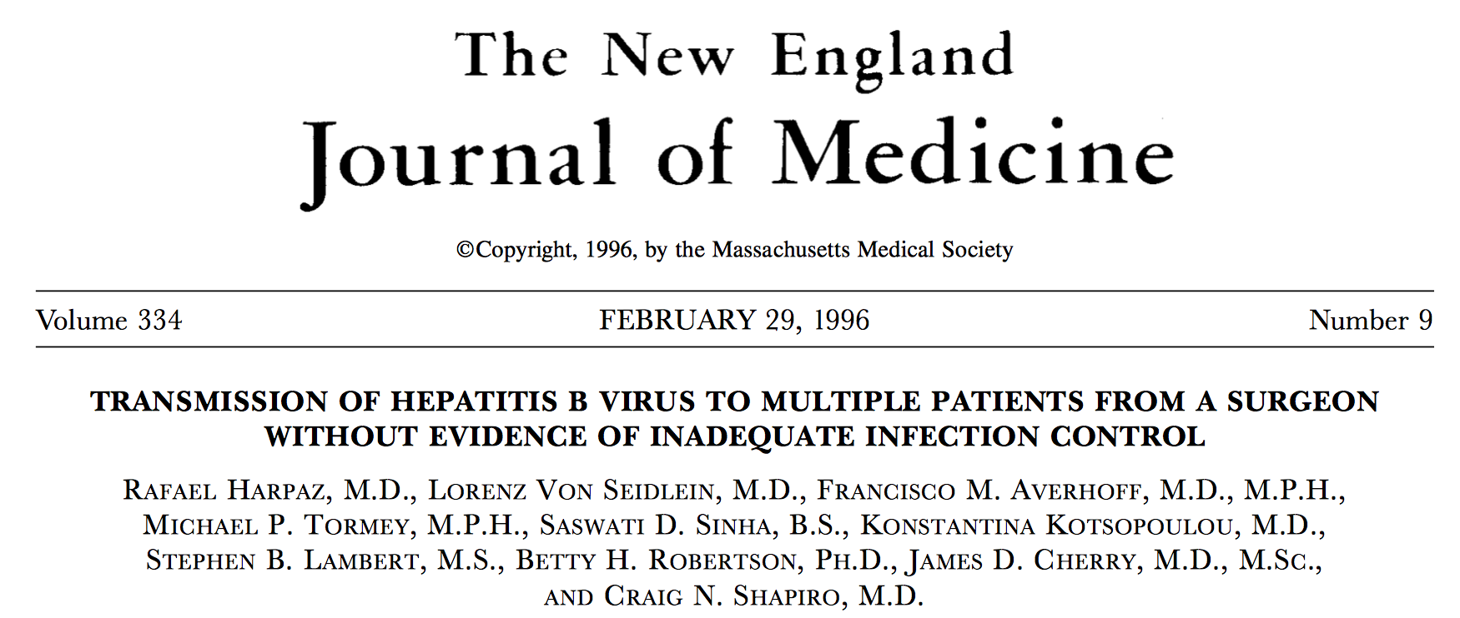
Hepatitis B Transmission – Provider-to-Patient
No specific events or breaks in technique were identified in either cluster that could explain transmission, although the surgical resident did not wear double gloves.

Slide 20
Hepatitis B Transmission – Provider-to-Patient
4. Since 1996 an additional twelve reports of hepatitis B transmission from providers to patients have been detected.
  These cases are generally associated with HBV infected surgeons; one case associated with an infected dentist;
  In a report from North America – 75 patients were infected from procedures involving placement of subdermal EEG electrodes by an HBeAg positive technician.
  A 2012 Clinical Infectious Diseases paper described two instances of provider-to-patient HBV transmission from an HBV ‘e’-antigen positive orthopedic surgeon who had a viral burden of >1.7 X 10⁷
CMAJ 2000; 162:1127–31.
Enfield KB, et al. Transmission of hepatitis B virus from an orthopedic surgeon with a high viral load. Clin Infect Dis, 2012;56(2):218-24.

Slide 21

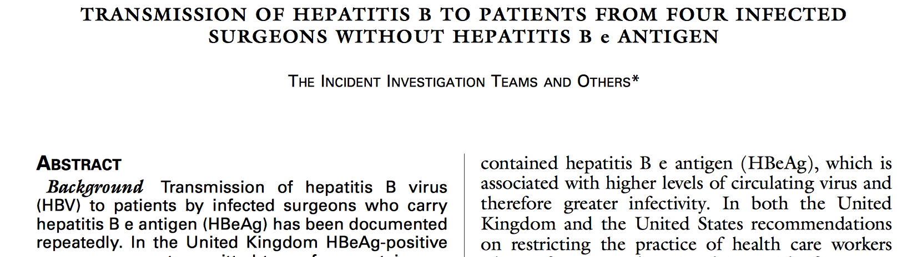
Hepatitis B Transmission – Provider-to-Patient
In four unconnected cases of acute hepatitis B infections, surgery was identified as a possible source. UK investigators tested the surgical teams. In each case a surgeon was found to be infected with so-called ‘precore mutants’ that were incapable of making ‘e’ antigen.
The Incident Investigation Teams and Others N Engl J Med. 1997;336:178-184

Slide 22
Hepatitis B Transmission – Provider-to-Patient
Because of several published instances of HBeAg-negative surgeons transmitting hepatitis B infection, some experts proposed HBV DNA quantitation as a more precise measure of infectivity, as well as to provide a basis for deciding whether they should be allowed to perform exposure-prone procedures.
Poole C. Lancet. 1997;350:218.
Noone P, Symington I, Carman W. Lancet. 1997;350:219.

Slide 23
Hepatitis C Transmission – Provider-to-Patient
Provider-to-patient transmission of hepatitis C has been rarely reported in the US; five documented reports in the literature since testing for this virus became widely available in 1990.
Conversely, in Europe, and particularly in the UK, transmission has been detected with a higher frequency.
  Ten separate instances; more than 350 cases of HCV infection in patients.
3. Healthcare provider intravenous substance use has been a common feature of several clusters.

Slide 24
Hepatitis C Transmission, Provider-to-Patient, U.S.*
Type of HCW Year Cases Reported Mode
OP surgical tech 1991-92 ~ 40 IVDU**
Anesthesiologist 1994 1/347 (0.3%) Possible IVDU**
Cardiac surgeon 2001 14/937 (1.5%) Exposure prone
procedures
Nurse anesthetist 2004 16/142 (11.3%) IVDU**
Surgical technician 2009 ~ 23 IVDU**
** Contaminated needles or narcotics used for self-injection
* Courtesy of Joseph Perz, DrPH, MA. Division of Healthcare Quality Promotion, CDC

Slide 25
HIV Transmission,
Provider-to-Patient
Nine cases, four providers, 25 years.
  Six cases associated with one US dentist
  Two cases in France, associated with two providers, one an orthopedic surgeon, the other a nurse providing postoperative care
  One case in Spain, in which a gynecologist transmitted to a single patient during a C-section
Lot F, et al. Probable transmission of HIV from an orthopedic surgeon to a patient in France. Ann Intern Med. 1999;130(1):1-6.
Goujon CP, et al. Phylogenetic analyses indicate an atypical nurse-to-patient transmission of human immunodeficiency virus type 1. J Virol. 2000;74(6):2525-32.
Mallolas J, et al. Transmission of HIV-1 from an obstetrician to a patient during a caesarean section. AIDS. 2006;20(2):285-7

Slide 26
HIV Transmission, U.S. – Dental Care
• Patient A - six visits; two third molar extractions, numerous procedures
• Patient B - 21 visits; extractions, prophylaxis, prosthodontics
• Patient C - 14 visits; extractions, periodontal scaling, restorative fillings
• Patient E - 14 visits; prophylaxis, fillings, crowns, endodontics
• Patient G - two visits; endodontics, restorative filling
• Patient I - one to three visits; prophylaxis, restorative fillings

Slide 27
HIV Transmission, U.S. – Dental Care
The Florida Case Cluster
Number of Patients in the Practice ~2000
Number of Patients Tested for HIV ~1100
Patients Infected with the Dentist’s Strain 6
Attack Rate 0.54%

Slide 28
Guidelines
Zero Risk
vs.
“Significant Risk”

Slide 29
What is ‘Significant Risk’ for Transmission?
“Significant Risk – Standard essentially set by “the reasonable medical judgment of public health officials” (Arline vs. School Board of Nassau County)
Factors characterizing a risk as “significant”*
  Nature of the risk (route[s] of transmission)
  Duration of the risk (period of infectivity)
  Severity of the risk (potential for harm)
  Probability of transmission and harm
* From an Amicus curiae brief filed in Arline vs School Board of Nassau County filed on behalf of the American Medical Association

Slide 30
Existing Guidelines – U.S.
HCWs who are infected with HIV or HBV and are ‘e’ antigen positive should not perform exposure-prone procedures unless they have sought the counsel of an expert review panel and been advised under what circumstances, if any, they may continue to perform these procedures. Such circumstances would include notifying prospective patients of the HCW’s seropositivity before they undergo exposure-prone invasive procedures.
Centers for Disease Control. MMWR Morb Mortal Wkly Rep. 1991;40(RR-8):1-9.

Slide 31
U.S. Guidelines
Subsequently, in 1991 Congress passed P.L. 102-141 mandating states to adopt “CDC guidelines or their equivalent”.
CDC attempted to develop a list of exposure-prone invasive procedures with the help of professional medical associations but no consensus was reached.

Slide 32
U.S. Guidelines
In 1992 Dr. William Roper, then CDC Director, in a letter to state health departments, noted that the states, not CDC, would certify equivalency and further stated that “... exposure-prone procedures are best determined on a case-by-case basis, taking into consideration the specific procedure, as well as the skill, technique, and possible impairment of the infected health-care worker.”
Thus, as a result, substantial variability exists in state guidelines, and the role of the expert review panel is underscored.

Slide 33
How Much Variability? How Outdated?
In 2009, my staff and I reviewed existing laws and policies and interviewed State Health Department officials in all 50 States to review current practices:*#
  To evaluate existing variability among State approaches to this issue;
  To determine how many State laws require prospective notification and/or the convening of Expert Review Panels;
  To determine if policies have been modified since the early 1990’s to incorporate new scientific knowledge.
* Relying on “Guidelines for HIV-Positive Health Care Workers.” The Center for HIV Law and Policy. http://www.hivlawandpolicy.org/resources/view/167, March 2008.
# Turkel S, Henderson DK. “Current Strategies for Managing Providers Infected with Bloodborne Pathogens”. Infect Control Hosp Epidemiol 2011;32(5), 1-7.

Slide 34
How Much Variability?
Only 3/50 States adopted CDC Guidelines directly;
42/50 States require an Expert Review Panel;
One State requires prospective notification of all patients;
One State requires prospective notification if transmission is shown to have occurred;
19 States require infected providers to notify patients of providers’ bloodborne pathogen infections – under highly variable circumstances
Twenty-two States do not require prospective notification;
Nine States’ guidelines do not address notification

Slide 35
How Outdated?
Only 3 of 50 States modified policies or laws since their initial passage in the early 1990’s;
Only one State had included HCV in its statute;
No State guideline, policy, or statute advocated the use of molecular methods or circulating viral burdens to assess provider risk.
Since only 18% of states reported that they had to deal with this issue in the last 5 years, we concluded that problems with providers:
  not being detected,
  are not occurring commonly, or
  are being managed at levels below State Health Departments

Slide 36
SHEA Guideline – 2010
SHEA assembled a panel of experts to assess the existing SHEA position paper (1997) and to determine whether an update was needed.
First conclusion – substantial progress in the BBP field since 1997 – not incorporated into the SHEA guidance.
This group ultimately took the bold position that the data assembled over the last quarter century provided strong footing – when coupled with new molecular methods – for a new, rational set of guidelines.
Drew heavily on table of clinical activities published by Reitsma and colleagues (Clin Infect Dis 2005; 40:1665–1672.)
These guidelines were published in February 2010

Slide 37
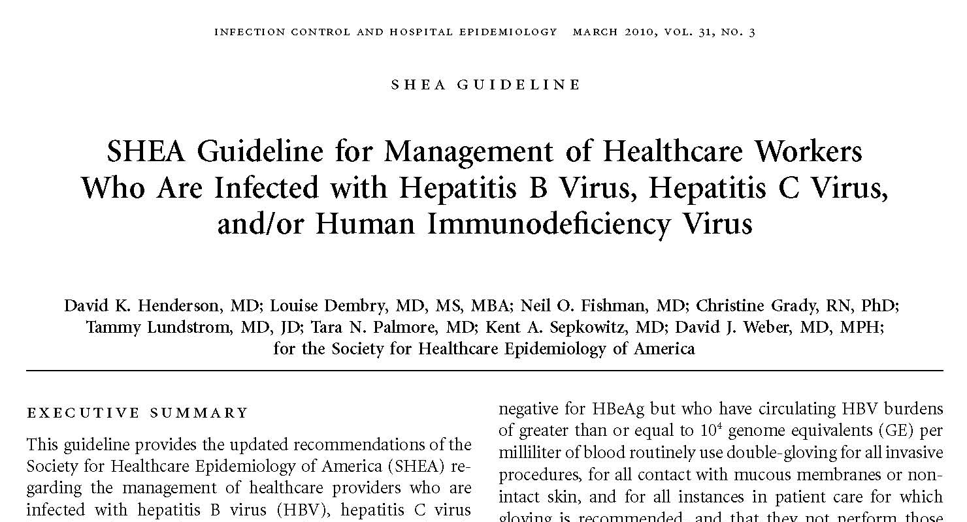

Slide 38
2010 SHEA Guideline – Hepatitis B*
Circulating Categories
Viral of Clinical Frequency Burden Activities Recommendation of Testing
<10⁴ GE/mL I, II, and III No restrictions** Twice
Annually
>10⁴ GE/mL I and II No restrictions** NA
>10⁴ GE/mL III Restricted**# NA
* Guideline emphasizes case-by-case management and encourages providers to work with their Occupational Medicine Staff and their physicians
** Consonant with State laws, and with guideline codicils
# Permissible only when viral burden is <10⁴ GE/mL

Slide 39
2010 SHEA Guideline – Hepatitis C*
Circulating Categories
Viral of Clinical Frequency Burden Activities Recommendation of Testing
<10⁴ GE/mL I, II, and III No restrictions** Twice
Annually
>10⁴ GE/mL I and II No restrictions** NA
>10⁴ GE/mL III Restricted**# NA
* Guideline emphasizes case-by-case management and encourages providers to work with their Occupational Medicine Staff and their physicians
** Consonant with State laws, and with guideline codicils
# Permissible only when viral burden is <10⁴ GE/mL

Slide 40
2010 SHEA Guideline – HIV*
Circulating Categories
Viral of Clinical Frequency Burden Activities Recommendation of Testing
<5 X 10² GE/mL I, II, and III No restrictions** Twice
Annually
>5 X 10² GE/mL I and II No restrictions** NA
>5 X 10² GE/mL III Restricted**# NA
* Guideline emphasizes case-by-case management and encourages providers to work with their Occupational Medicine Staff and their physicians
** Consonant with State laws, and with guideline codicils
# Permissible only when viral burden is <5 X 10² GE/mL

Slide 41
Infected Provider “No Restriction” Codicils
No restrictions recommended, so long as the infected healthcare worker:
(1) is not detected as having transmitted infection to patients;
(2) obtains advice from an Expert Review Panel about continued practice;
(3) undergoes follow-up routinely by Occupational Medicine staff (or an appropriate public health official), who tests the provider twice per year to demonstrate the maintenance of a viral burden of less than the recommended threshold;

Slide 42
Infected Provider “No Restriction” Codicils
No restrictions recommended, so long as the infected healthcare worker:
(4) receives follow-up by a personal physician who has expertise in managing HIV infection and who is allowed by the provider to communicate with the Expert Review Panel about the provider’s clinical status;
(5) consults with an expert about optimal infection control procedures (and strictly adheres to recommended procedures, including routine double-gloving and frequent glove changes for Category II and III procedures, particularly if performing technical tasks known to compromise glove integrity); and
(6) agrees to the information in, and signs a contract or letter from, the Expert Review Panel that characterizes her or his responsibilities.

Slide 43
Rationale for Viral Burden Cutoffs
For HBV and HCV cutoffs, one modeling experiment suggested that a suture needlestick exposure to a provider who had a viral burden of 10⁴ GE/mL would be associated with an exposure to less than 1 virion.
Since allowing HIV-infected practitioners to participate in category III procedures is virtually unprecedented, we chose a conservative cutoff. Since HIV infected individuals who have “undetectable” viral burdens occasionally spike to 500 GE/mL, we chose 5 X 10² as the cutoff.

Slide 44
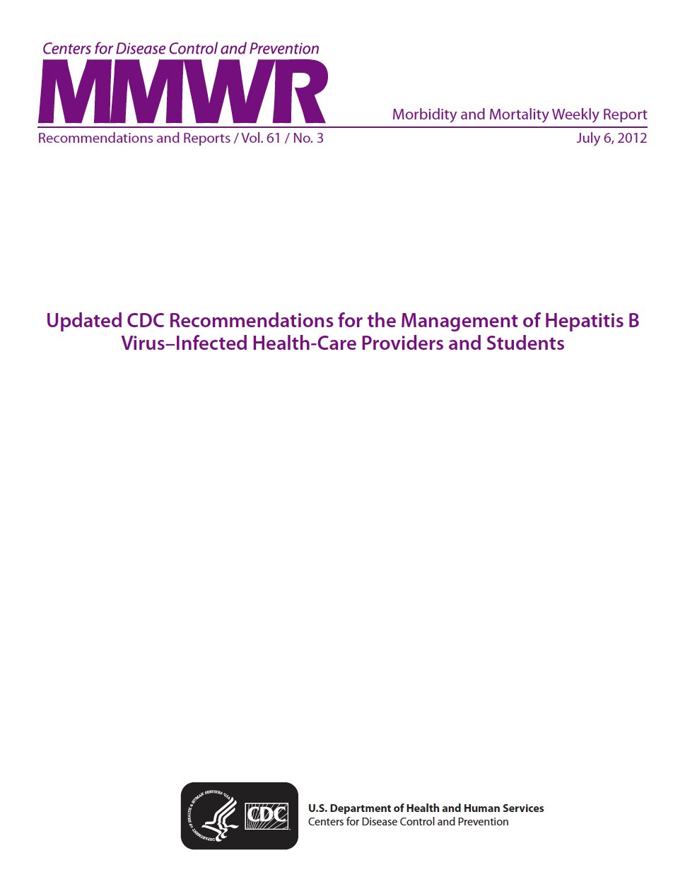

Slide 45
Changes to HBV Guidelines – U.S.
July 6, 2012
Chronic HBV infection in itself should not preclude the practice or study of medicine, surgery dentistry or allied health professions.
HBV-infected do not need to ‘pre-notify’ patients of their infection status.
HBV DNA levels (as opposed to ‘e’ antigen) used to monitor infectivity;
Threshold considered “safe to practice” set at 1,000 IU/ml.
Expert review panel only needed for exposure prone procedures

Slide 46
Changes to Guidelines – U.S.
July 6, 2012
These guidelines do not address workers infected with HCV.
These guidelines do not address workers infected with HIV.

Slide 47
U.S. – CDC HCV Guidelines – 2014
Hepatitis C “Frequently Asked Questions for Health Professionals”
Should HCV-infected health care personnel be restricted in their work?
“There are no CDC recommendations to restrict a health care worker who is infected with HCV. The risk of transmission from an infected health care worker to a patient appears to be very low. All health care personnel, including those who are HCV positive, should follow strict aseptic technique and Standard Precautions, including appropriate hand hygiene, use of protective barriers, and safe injection practices.”
http://www.cdc.gov/hepatitis/HCV/HCVfaq.htm#f4
Created July 21, 2008
Last updated: November 17, 2014

Slide 48
The Bottom Line
What, if any, level of provider-to-patient risk is tolerable?
What, if any, risks are associated with a highly restrictive policy?
How does one fairly balance these complex and directly competing risks?
How does the magnitude of provider-to-patient risk compare to other prevalent risks for patients in healthcare?
If one elects to implement a less-restrictive policy, what can be done to mitigate identifiable risks?

Slide 49
Contact Information
E-mail – dkh@nih.gov
Telephone – 301-496-3515

